Slide 1


Math Interpreter
Group 7
Prof. D. J. Joshi
Sagar Sikchi 11810844
Pradunya Maladhari 11811567
68. Talib Hussain 11811318
Shantanu Sontakke 11810898
Aadarsh Kandewar 11810942

Slide 2
Contents
Implementation
Tokens
Parser
Interpreter
Input-output Form

Slide 3
Implementation
Language used – python
Lexer : generate tokens – working on character level
Parser : generate parse tree – working on token level
Interpreter : evaluate parse tree – working on node level
File handling

Slide 4
Tokens
57.60 + 117 * 100 ^ 15
TokenType
NUMBER
Value
57.60
TokenType
PLUS
Value
None
TokenType
NUMBER
Value
117
TokenType
MULTIPLY
Value
None
TokenType
NUMBER
Value
100
TokenType
EXPONENT
Value
None
TokenType
NUMBER
Value
15

Slide 5
Parser
ADD Operation
57.60 + 117 * 100 ^ 15
NUMBER
Value: 57.60
MULTIPLY Operation
NUMBER
Value: 117
EXPONRNT Operation
NUMBER
Value: 100
NUMBER
Value: 15

Slide 6
Grammar Rule
Term_1
Term_2
57.60 + 117 * 100 ^ 15
Expression
Factor
^
57.60
117
100
15
+
*

Slide 7
Interpreter
Input expression –
57.60 + 117 * 100 ^ 15
After parsing the expression becomes –
(57.60+(117.0*(100.0^15.0)))
From this, interpreter will able to understand which operation should be performed first.

Slide 8
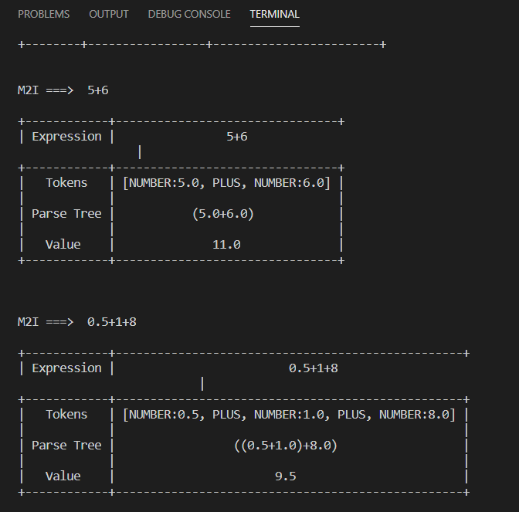
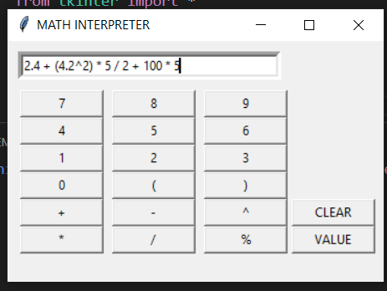
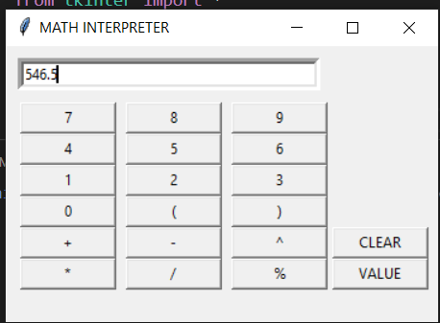
Input-Output Form

Slide 9
Thank You

